Slide 1
BRITISH AIRWAYS
CUSTOMER REVIEW DATA ANALYSIS

Slide 2
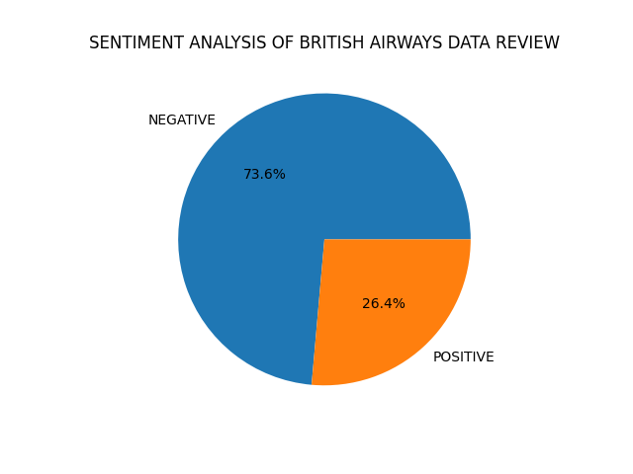
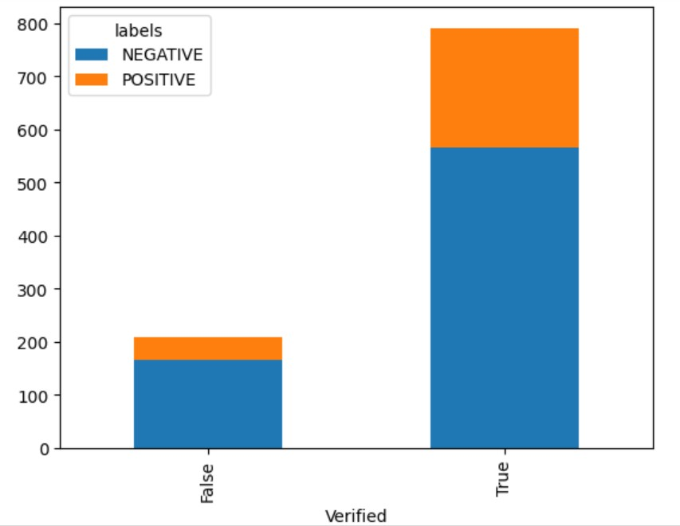
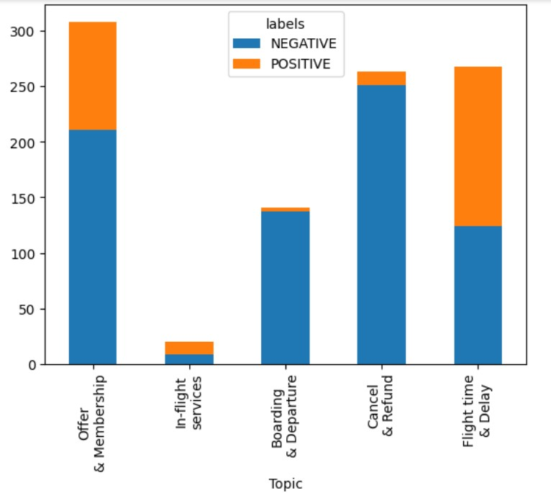

Insights from the analysis
1000 total reviews collected
736 negative reviews, and 572 of them are from verified trip
264 positive reviews, and 219 of them are from verified trip
The most talked topic is regarding “Offer & Membership” with 308 reviews, and 94 of them are positive reviews
The least talked topic is regarding “In-flight services” with only 20 reviews
The most negative topic is regarding “Cancel & Refund”
The most positive topic is regarding “Flight time & Refund”

